Slide 1
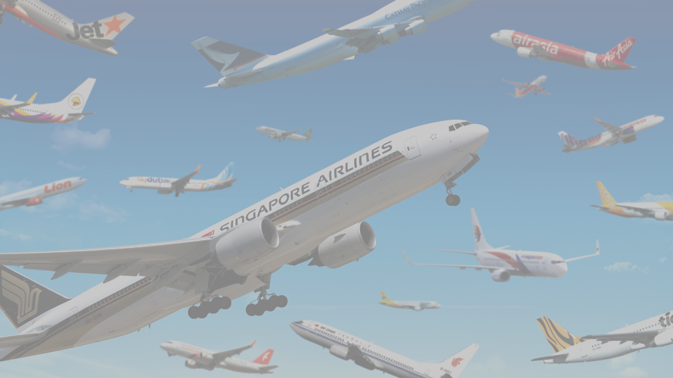
Air ticket reservation management system
created by
Myo Thet Tun

Slide 2

Overview of implemented features
Entity Relationships Diagram
Use Case Diagram
Class Diagram
Initial Screen Design Developments with Visual Studio
Actual Screen Design Developments (ongoing process)

Slide 3
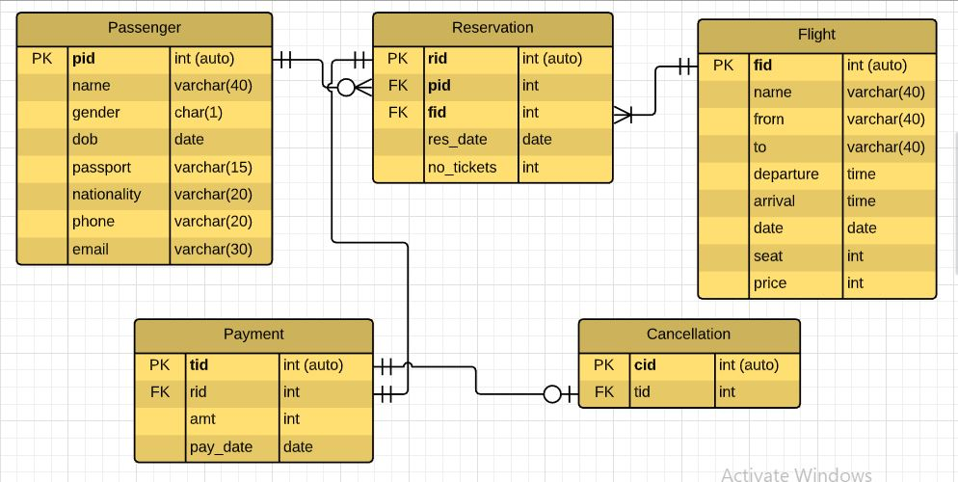
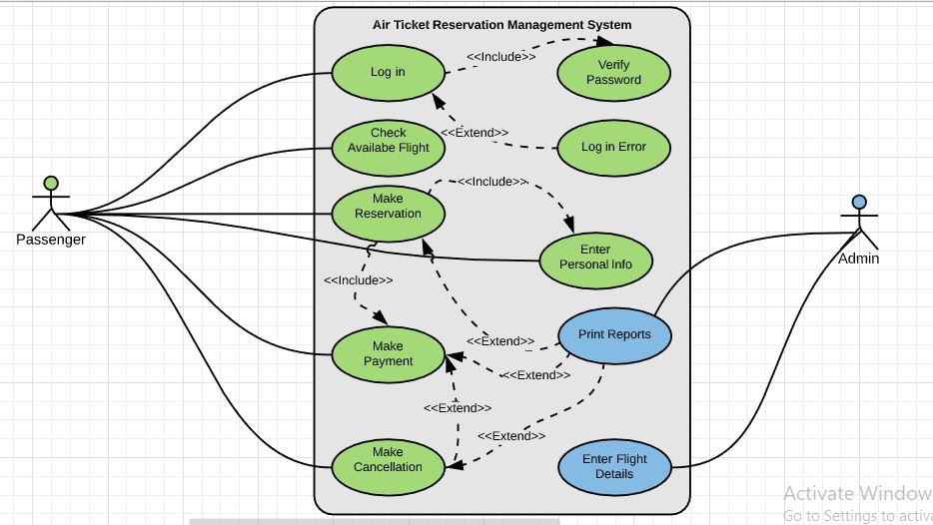
ERD & Use Case Diagrams

Slide 4
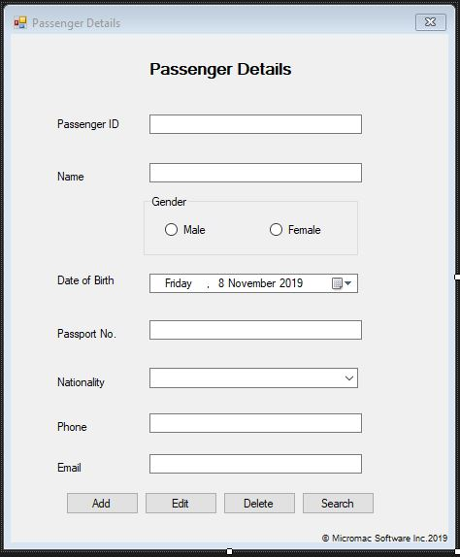
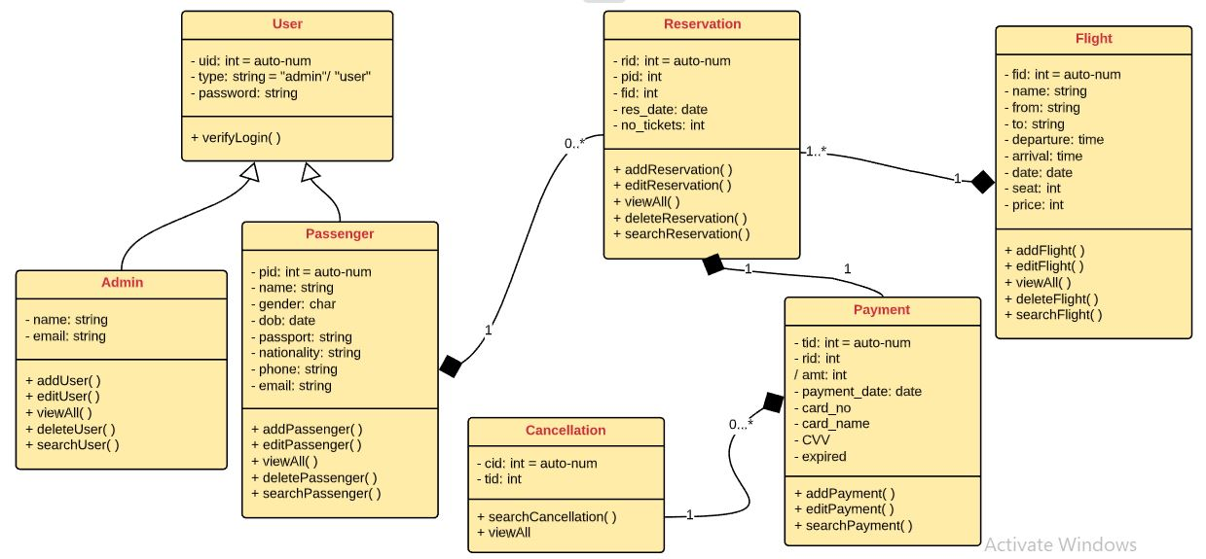
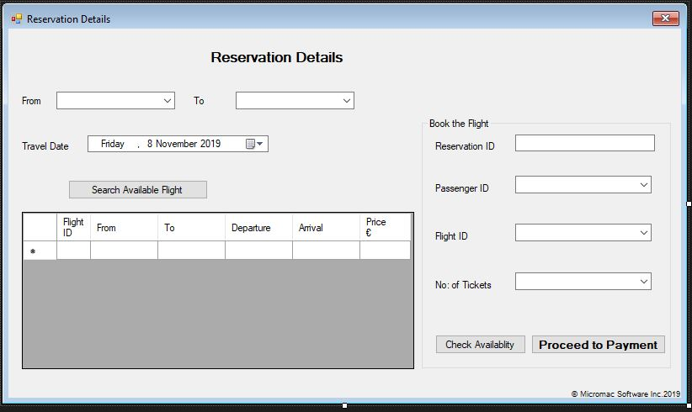
Class Diagram & Initial Screen Designs

Slide 5
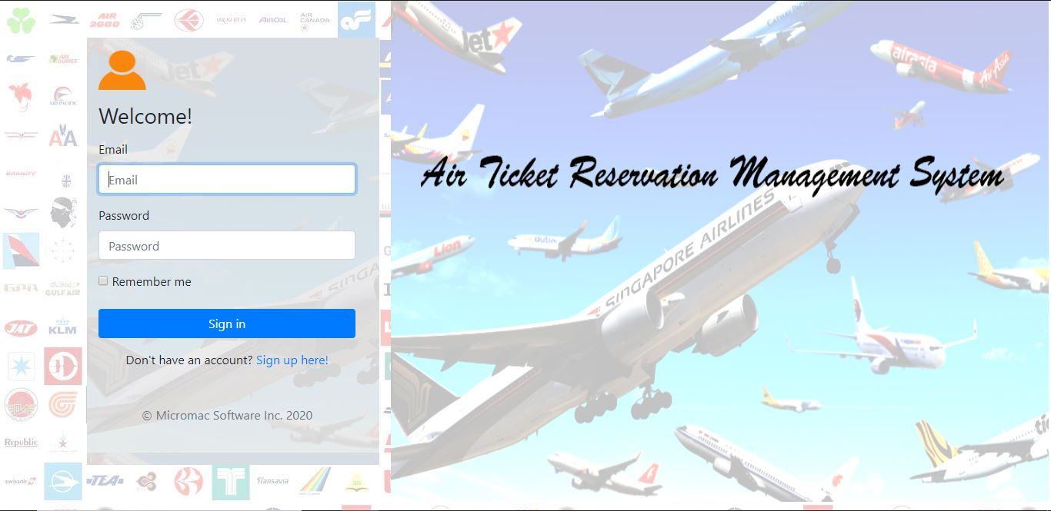
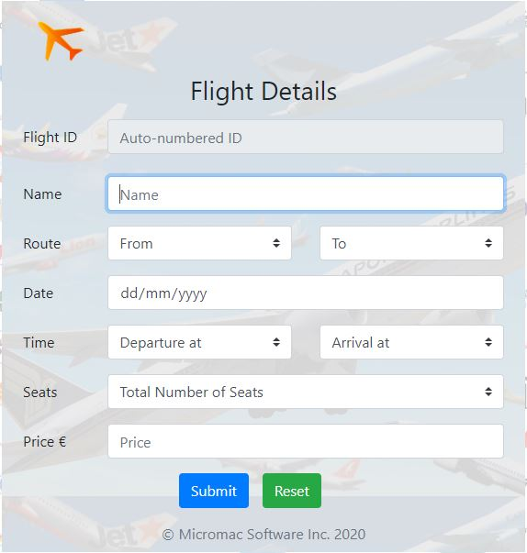
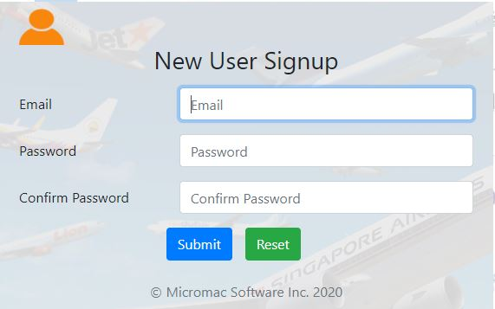
Actual Screen Designs

Slide 6

The most challenging features
Web page creation with Bootstrap Framework
User vs Admin (2 different environments?)
Web programming (JavaScript - client side & PHP – server side)

Slide 7

Scope of the system
6 Tables (User, Flight, Passenger, Reservation, Payment, Cancellation)
7 classes (User, Admin, Passenger, Reservation, Cancellation, Payment, Flight)
Possibly 9 web pages

Slide 8

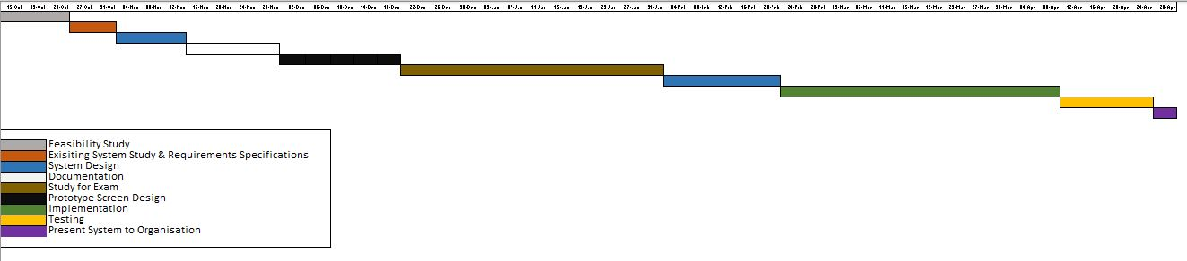
Timeline

Slide 9

Summary
What I have done so far -
ERD, Use Case, Class, Initial Screen Designs, Actual Screen Designs
What is the next step?
Form Validations, Database Connections, System Integration and Testing
And finally,
A fully-functional web-based “Air Ticket Reservation Management System (ATRMS)”

Slide 10
The End
If (presentation.end == True) {
print (“This is the end of presentation”);
print (“Thank you for listening!”);
presentation.close();
}
© Micromac Software Inc. 2020. All rights reserved.

